Slide 1
CSE - 438
Generating Emotionally Expressive Look-At Animation
Data Science
Name : Hasim Reza
ID : 21301343
Section : 01

Slide 2
Introduction:
Video game animation heavily depends on motion capture technology.
By this field we can introduced to neural networks to generate look-at animation of equal appeal to motion capture.
This also include the data set as the foundation for training neural network.it include diverse motion sequences and interaction.
Feature engineering involves extracting motion parameters for target direction.

Slide 3
Building blocks:
1. Dataset Collection : Gather a diverse collection of data for the motion capture
For the range of emotions,characters,interaction scenarios.
2. Preprocessing : Clean and preprocess the data for the motion and capture sequences with look-at target.
3. Encoder : By an encoder to process the input data and a decoder for generate the look-at animation.
4. Pose Consistency loss : Ensuring that the generated animation maintains the pose and motion coherence.
5.Real-time implementation : For the model to be ready for real-time performance.ensuring that the generated animation can be used in an interactive environment.

Slide 4
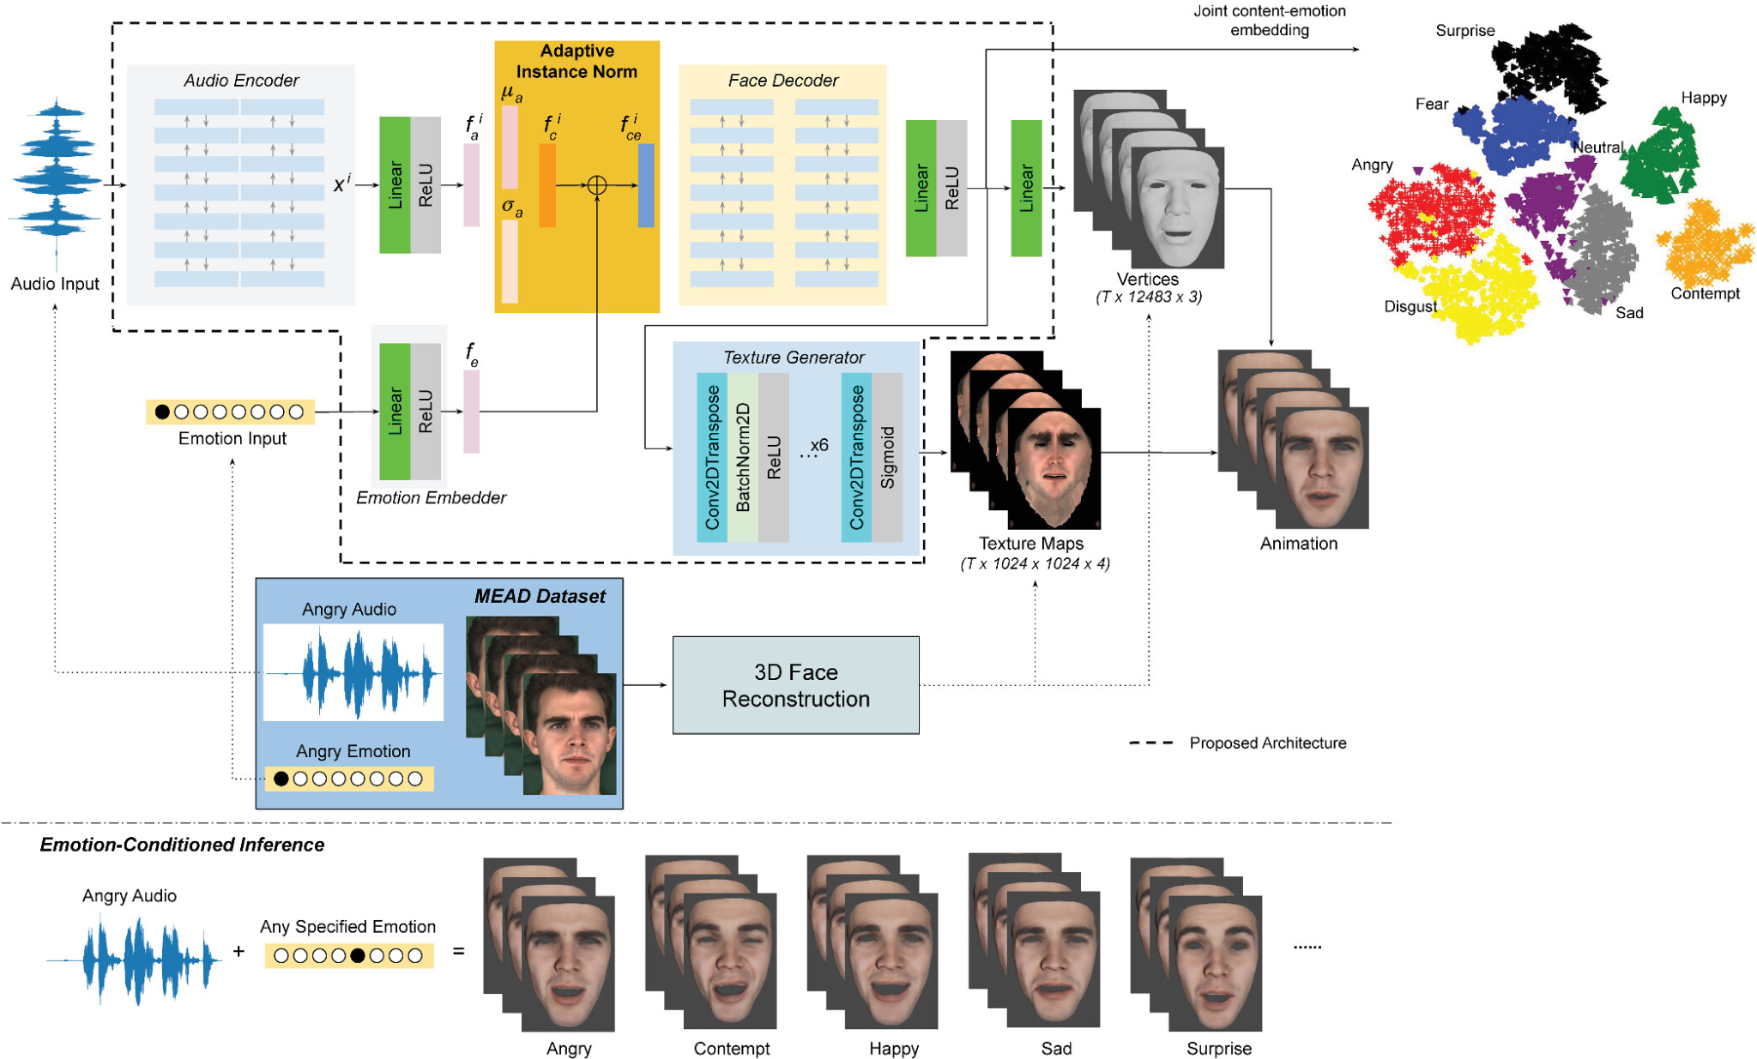

Slide 6
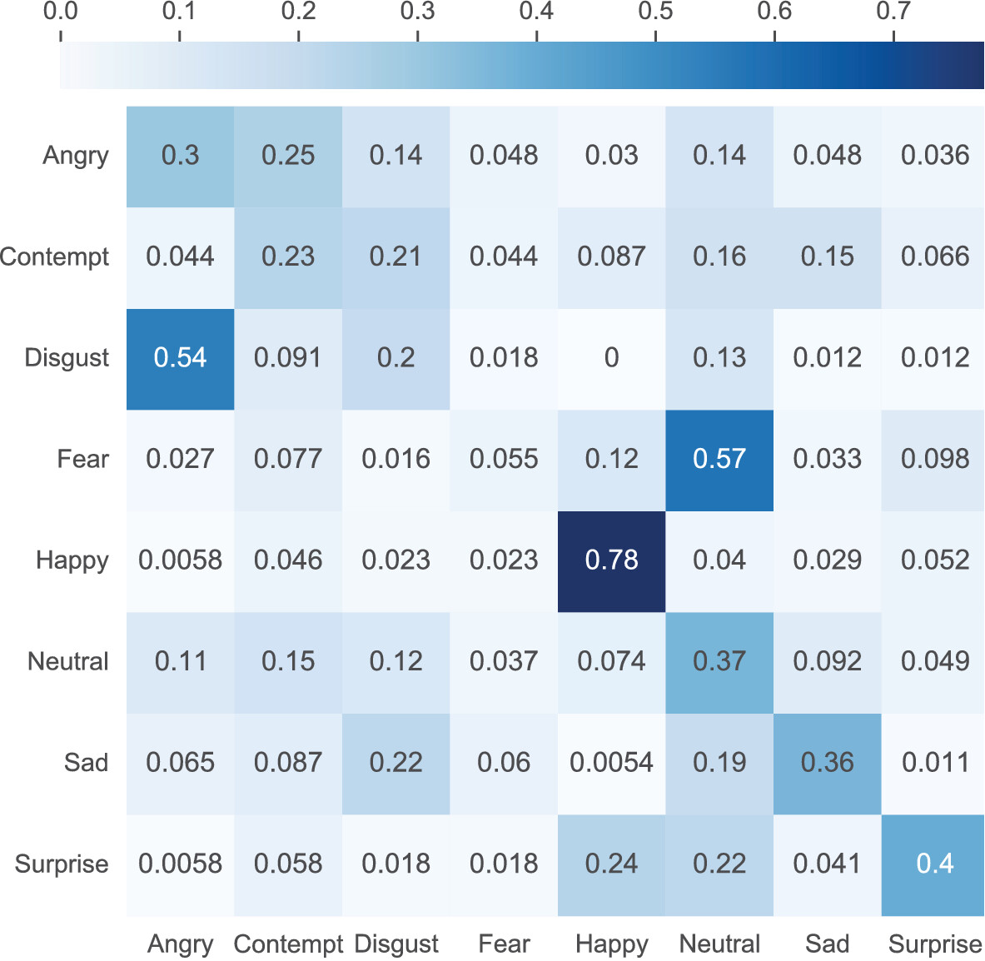

Slide 7
Conclusion
The animation can be better by focusing on the eye movement and for the emotion recognition by utilizing dataset and algorithm.
The animation techniques to bring emotions to life, more focus on the subtle movement by using data-driven feature engineering.
Using statistical model for predict emotional shifts and by using feedback loops we can refine animation, leveraging insights from testing.

Slide 8
Improvement
Character Development and Rigging.
Animation Finesse.
Dynamic Eye focus and Movement.
Iterative Refinement.

